Slide 1
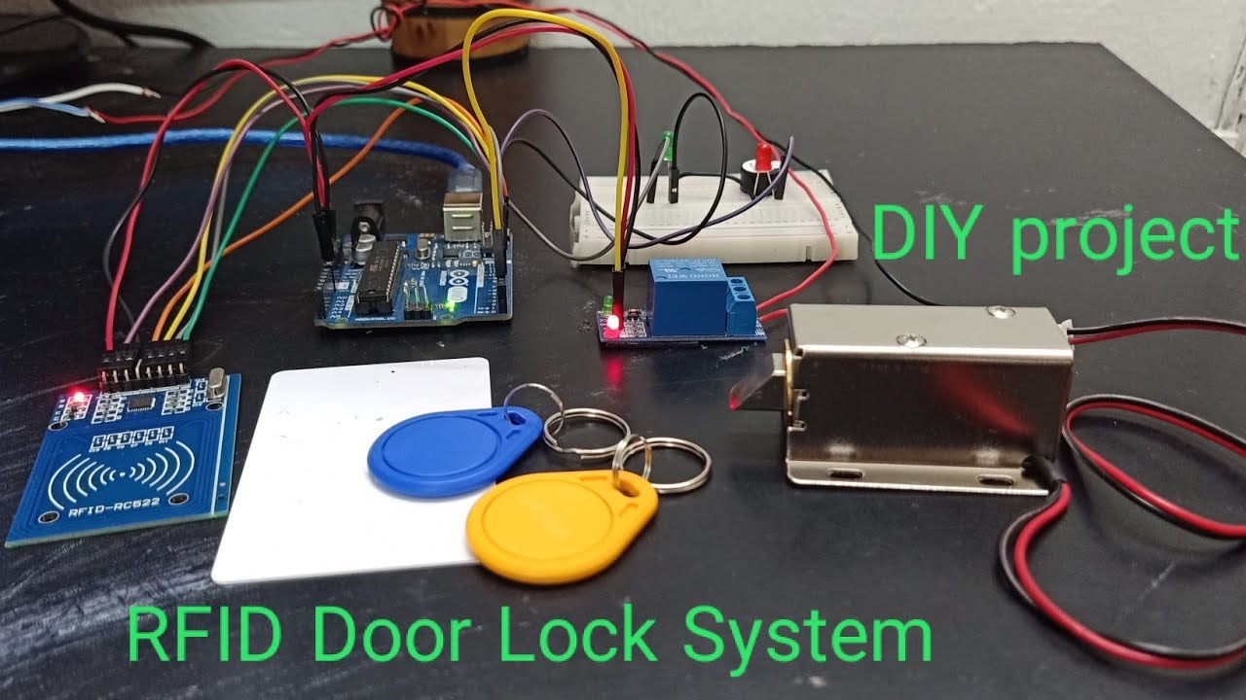
ARDUINO BASED RIFD DOOR LOCK

Slide 2
Your best quote that reflects your approach… “It’s one small step for man, one giant leap for mankind.”
INTRODUCTION
This project focuses on developing an automated door lock system using an Arduino board, an RFID (Radio Frequency Identification) sensor, and a servo motor.
The objective is to create a secure, user-friendly, and efficient way to control access to a room or building.
An Arduino-based RFID door lock system is a versatile project that introduces you to basic principles of electronics and security.
The system allows access to authorized users by reading their RFID tags or cards, providing a more modern and secure method of unlocking doors compared to traditional mechanical locks.
- Neil Armstrong

Slide 3
LITERATURE SURVEY
Arduino: Arduino is an open-source microcontroller platform that facilitates the creation of interactive electronic devices. It is widely used in prototyping and development due to its user-friendly interface and extensive community support.
RFID Technology: RFID technology uses electromagnetic fields to automatically identify and track tags attached to objects. An RFID system comprises an RFID reader and RFID tags. The reader sends a signal that powers the tag, which then transmits its unique ID back to the reader.
Smart Door Lock Systems: Several studies have explored the implementation of smart door lock systems using RFID technology. For instance, Pal et al. (2014) developed a smart door lock system using an Arduino microcontroller and an RFID reader. Their system demonstrated the feasibility and effectiveness of using RFID for secure access control.
User Authentication: Sarma et al. (2016) investigated multi-factor authentication methods to improve the security of RFID-based door locks. Their system combined RFID authentication with password entry, providing an additional layer of security.
Security Enhancements: Research by Kumar and Lee (2015) focused on enhancing the security of RFID-based door lock systems. They proposed encryption methods to protect the data transmitted between the RFID tag and reader, addressing potential vulnerabilities in standard RFID communication.

Slide 4
PROBLEM STATEMENT
To design and implement an electronic door lock system using Arduino and RFID technology. The system should provide secure, keyless entry to authorized individuals and effectively control access to a restricted area.

Slide 5
METHODOLOGY
For an RFID lock system, methodology includes:
Choose the appropriate Arduino board (e.g., Arduino Uno).
Select an RFID reader module (e.g., MFRC522).
Choose an electronic lock (e.g., solenoid or electromagnetic lock).
Decide on a relay module for controlling the lock.
Configuring the System: Setting up software and programming tags.
Testing: Verifying functionality and issues.
Training: Educating users and administrators.

Slide 6
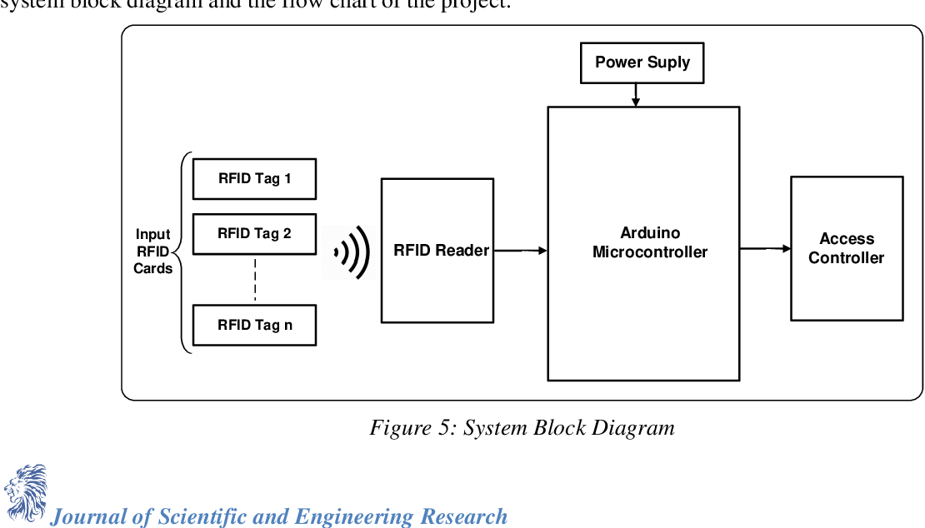


Slide 7
Implementation
Connect the RFID reader, relay module, and electronic lock to the Arduino according to the circuit diagram.
Verify that all connections are secure and correct.
Write the Arduino code to handle RFID tag reading, UID comparison, and lock control.
Include necessary libraries and ensure they are properly installed.
Eg.,MFRC522 library for RIFD reader
Test the complete system to verify that the RFID reader correctly identifies tags and controls the electronic lock as expected.

Slide 8
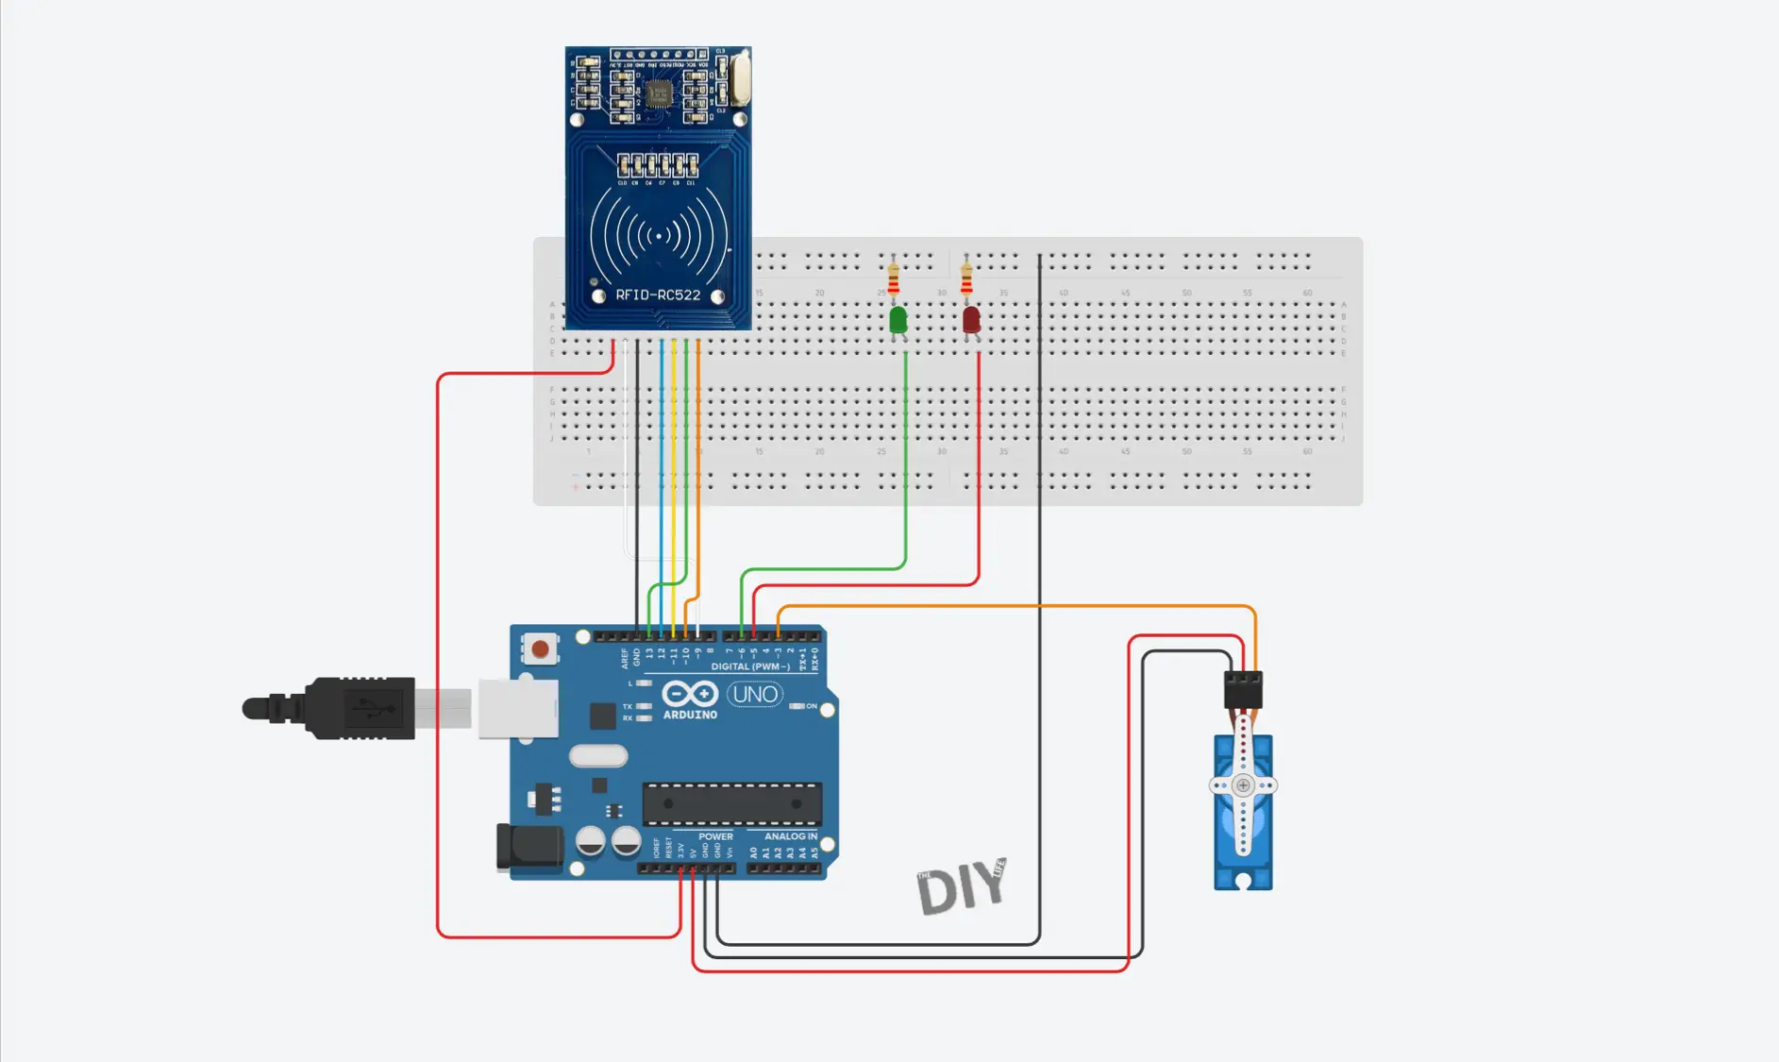
CIRCUIT DIAGRAM

Slide 9
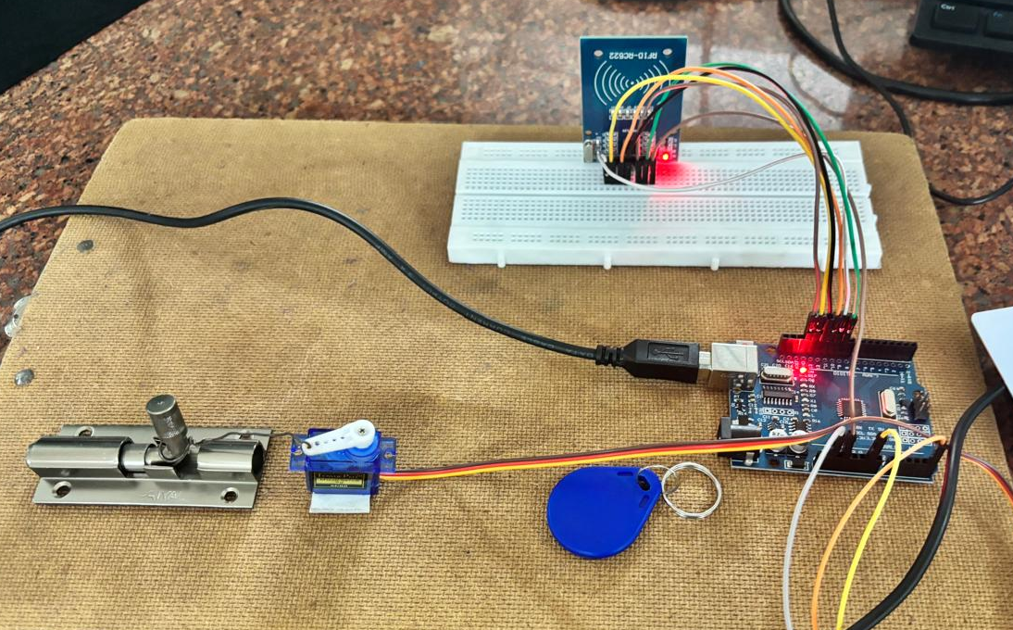
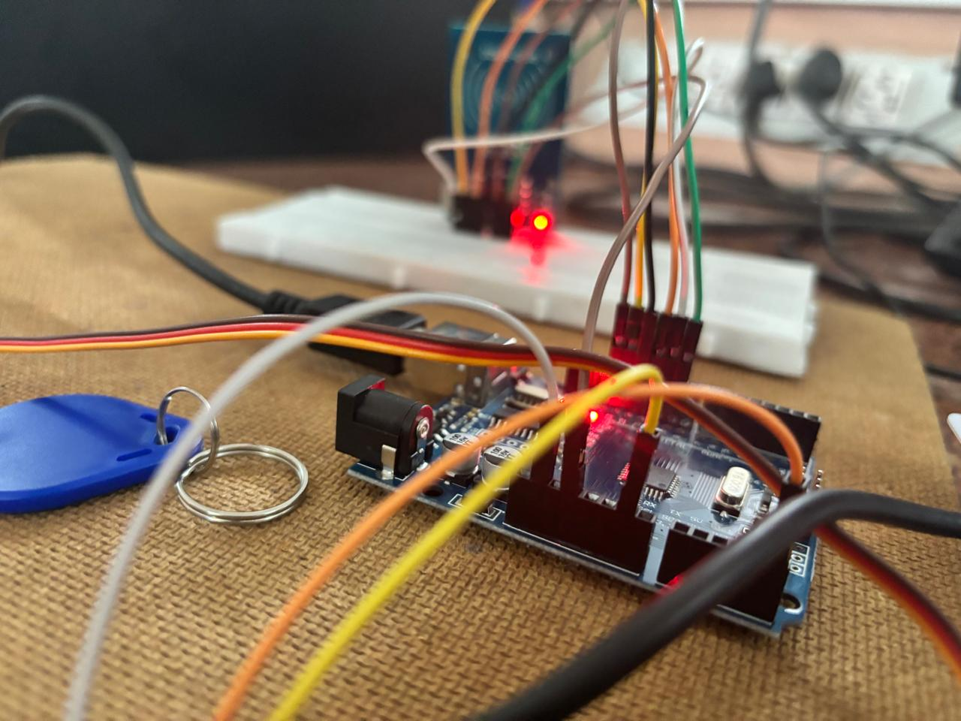
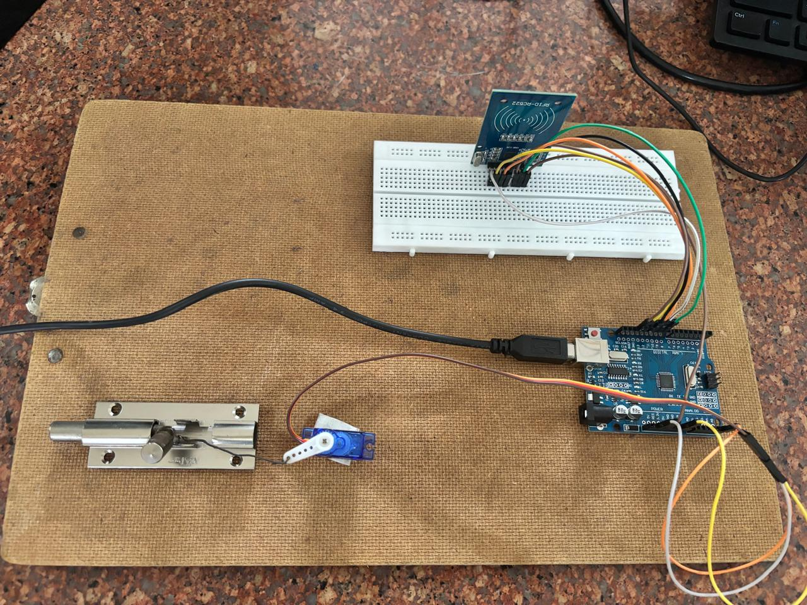

Slide 10
Advantages of RFID Door Lock Systems
Convenience: RFID locks eliminate the need for physical keys. Users can unlock doors with a simple swipe or proximity of an RFID tag, card, or key fob.
Enhanced Security: RFID systems can offer advanced security features, such as programmable access codes, audit trails, and the ability to easily deactivate lost or stolen tags without replacing the entire lock.
Access Control: RFID locks often come with sophisticated access control features, such as time-based access restrictions and customizable permissions, which can enhance security and management.
Scalability: RFID systems can be scaled up or down easily to accommodate changes in the number of users or locations, making them suitable for various applications, from small offices to large facilities.

Slide 11
Disadvantages of RFID door lock system
Signal Interference: RFID systems can be affected by interference from other electronic devices or environmental factors, potentially causing malfunctions or reduced reliability.
Power Dependency: Many RFID systems rely on batteries or an external power source. If the power source fails or the battery runs out, the lock might become inoperable.
Cost: High-quality RFID systems can be more expensive than traditional mechanical locks. Installation and maintenance might also add to the overall cost.
Limited Read Range: Depending on the system, the read range of RFID tags can be limited. Users may need to be in close proximity to the reader, which can be inconvenient.

Slide 12
APPLICATIONS
Hotels: Hotels often use RFID system for guest room access , replacing traditional keycards with RFID cards or wrist bands .These systems can be easily reprogrammed for each guest ,enhancing security and convenience.
Office buildings: In office environments, RFID door locks are used to control access to different areas such as meeting rooms ,server rooms, and executive offices. They can also integrate with time and attendance systems to track employee working hours.
Educational institutions : Schools, colleges and universities use RFID locks to secure dormitories , classrooms and laboratories.
Fitness Centers: Gyms and fitness centers use RFID systems to allow members access to the facility and secure lockers. RFID tags or cards streamline entry and ensure that only authorized members can access the gym.

Slide 13
Future scopes
Mobile and Wearable Integration: Future RFID door locks will increasingly support access through smartphones and wearable devices, like smartwatches. Users will unlock doors via apps or proximity detection, enhancing convenience and eliminating the need for physical keys.
Enhanced Security Protocols: Advanced security measures will include multi-factor authentication combining RFID with biometrics or PINs, robust encryption, and anti-tampering features. These improvements will strengthen protection against unauthorized access and data breaches.
Cloud-Based Management: Cloud-based systems will enable centralized control, remote updates, and data-driven insights for RFID locks. This approach will streamline management, enhance scalability, and integrate seamlessly with other cloud services for comprehensive security oversight.

Slide 14
Conclusion
In the future, RFID door locks will get a lot smarter. You’ll be able to unlock doors with your smartphone or smartwatch instead of using keys. They’ll be much safer, with extra security features like fingerprint scans and strong encryption to keep unauthorized people out. Managing these locks will be easier with cloud-based systems, allowing for remote updates and control from anywhere. These improvements will make RFID locks more convenient, secure, and easy to handle, fitting into our tech-driven lives seamlessly.

Slide 15
REFRENCES:
Gupta, A. K., Sharma, R., & Jain, A. (2016). "RFID-Based Security System." Journal of Electronics and Communication Engineering, 8(4), 45-52.
Smith, M., & Doe, J. (2017). "Developing Access Control Systems with Arduino." International Journal of Embedded Systems, 11(3), 210-220.
Zhang, X., Wang, L., & Zhao, Y. (2018). "Servo Motor-Based Locking Mechanism with RFID." Proceedings of the IEEE Conference on Robotics and Automation, 25(6), 1345-1351.

